Slide 1

COMPUTER SOFTWARE
GAYATRI VIDHYA PARISAD COLLEGE OF ENGINEERING FOR WOMENS
BY
Name : Batchu Poojitha
Roll No.: 324103210014
Class : CSE-1
Facility : Rohini Mam

Slide 2
Table of Contents
What is a Computer Hardware and Computer Software………………..3
Types of Software……………………………………………………….6
What is System software………………………………………………...7
Types of System software……………………………………………….8
What is Application software……………………………………………9
Types of Application Software…………………………………………..10
Difference between System software and Application software………..11

Slide 3
HARDWARE
Hardware is Computer’s tangible components or delivery systems that store and run the written instructions provided by the software.
Example: Hard Disk, Mother board, SSD, etc……
SOFTWARE
Software is a set of programs which tells computer’s hardware “What to do” and “How to do”. It is used to operate computer and execute specific tasks.
Example: Operating system, Utility software, Firmware, etc……

Slide 4
Software
System Software
Operating system
Firmware
Application software
Entertainment software
Educational software

Slide 5
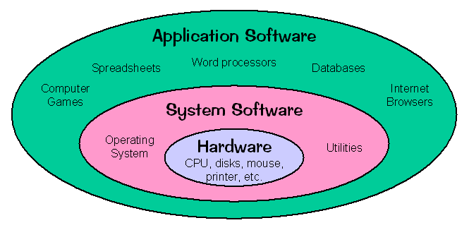

Slide 6
TYPES OF SOFTWARE
Software can be mainly divided into two types. They are:
System Software
Application Software
Other Software

Slide 7
SYSTEM SOFTWARE
System Software is a type of software which act as intermediate between hardware and user. It refers to the low level software that manages and controls a computer’s hardware and provides basic services to higher level software.
Example: Operating System, Utility Software, etc…..
Functions of System Software:
Process Management
Memory Management
File system Management
Input\Output Management
Interrupt Handling
Resource Allocation

Slide 8
TYPES OF SYSTEM SOFTWARE
1. Operating System: Manage computer hardware and provide a platform for running applications
Example: Windows, MacOS, Linux, etc……
2. Utility software: Performs specific tasks, such as disk formatting, backups, and virus scanning.
Example: Norton Antivirus, WinZip, etc…..
3. Device Drivers: Controls and interact with hardware devices.
Example: Printer drivers, Graphics drivers, etc…..
4. Firmware: Permanently stored software in ROM that controls hardware services.
Examples: BIOS(Basic Input /Output System), UEFI(Unified Extensible Firmware Interface), etc…..
5. Boot Loaders: Load the OS into memory during the boot process.
Example: GRUB(GNU gRand Unified Bootloader), Boot camp, etc….

Slide 9
APPLICATION SOFTWARE
Application Software is a type of software which provide interface for users to interact with the computer. It also refers as software that performs specific functions for a user.
Example: Ms Word, Google Chrome, etc…..
Functions of Application Software:
Data processing
User interface
File management
Networking
Security

Slide 10
TYPES OF APPLICATION SOFTWARE
1. Productivity Software: Word Processing, Speard sheet analysis, Presentation design
Example: Ms Office, Google, Workspace, etc…….
2. Graphics and Design Software: Image editing, graphic Design, Video editing
Example: Adobe Photoshop, Illustrator, Premiere, etc……
3. Multimedia Software: Media players, audio editors, video games
Examples: VLC, Audacity, Minecraft, etc….
4. Database Management Software: Data Management, Data analysis, Data visualization
Examples: Ms Access, Oracle, Tableau, etc…..
5. Communication Software: Email Clients, Instant messaging, Video conferencing
Examples: Ms Outlook, Slack, Zoom, etc……
6. Education Software: Learning management system, Educational games, simulation software
Example: Black Board, Duo lingo, SimCity, etc….
7. Entertainment Software: Video games, Simulation games, Multimedia players
Examples: Fornite, Minecraft, Netflix, etc……

Slide 11
DIFFERENCE BETWEEN SYSTEM SOFTWARE AND APPLICATION SOFTWARE
SYSTEM SOFTWARE
APPLICATION SOFTWARE
Gives path to software application to run
A general purpose software
Low level is used
Programming is complex when compared to application software
Interacts with the hardware directly
Ex: Operating System, Programming Language, etc…..
Designed and build for specific task
A specific software
High Level Language
Programming is simple when compared to system software
Does not take the hardware into consideration, as it does not interact directly
Ex: Word Doc, Spreadsheet, Database, Internet Explorer, etc……

Slide 12


